Slide 1
Introduction to ImarisXT using Matlab

Slide 2
Today
Introduction
6 slices of presentation
Examples
3 examples
Exercises
4 exercises
Q/A session, wrap up
But please ask anytime!

Slide 3
ImarisXT - Motivation
Imaris provides key features for analysis
File IO, segmentation, tracking, visualization, interaction, statistics, …
eXTend Imaris functionality
Flexibility of programming language (Matlab, Python, …)
Existing or custom code

Slide 4



ImarisXT - Functionality
Transfer data from and to Imaris
Image properties and intensities
Spots, Surfaces, Filament, Cells properties and coordinates
Open/Save files (allows batch processing)
Image processing
Control application state (current view)
Take snapshot (allows creating custom movies)
Supported languages and environments:

Slide 5
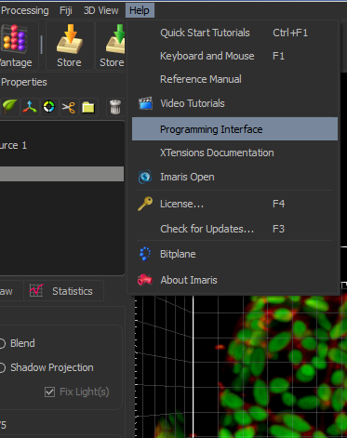
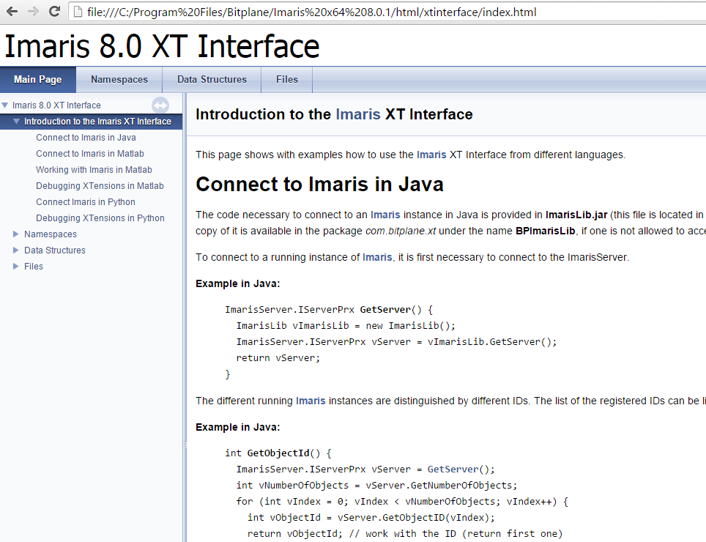
ImarisXT - Documentation

Slide 6
ImarisXT - Workshop
Examples
Invert middle slice
Creating a spot in the middle of the image
Count selected spots
XTensions deployment
Make them available in Imaris
Exercises
Move image and spots
Selective image intensities mapping
Proximity tracking
Detect spots and create histogram of statistics

Slide 7
Guidelines
Please try to solve the exercises on your own
Ask me or your neighbour when stuck
Take your time to explore XT and Matlab
Discuss your solution with your neighbour
I’ll be glad to have a look if I find the time
Have fun

